Slide 1
SRS Sadria Society Bishuddho Bishyaon Somobay Sommittee
Prepared by : Md Yasin Arif
Supervised by : Rajaul Islam
Technology : Java Swing & MySQL

Slide 2
Requirements
Sadria Society Bishuddho Bishyaon Somobay Sommittee wants to develop there all Financial transition using a Desktop Application they want to record there all members and investors information (personal & transition). Overview there hole deposit and investment and print individual statement.

Slide 3
Requirements analysis
Create Saving A/C
Create Investment A/C
Recording Transition
Summary of Transition
Print Statement
Overview of Deposit and Investment

Slide 4
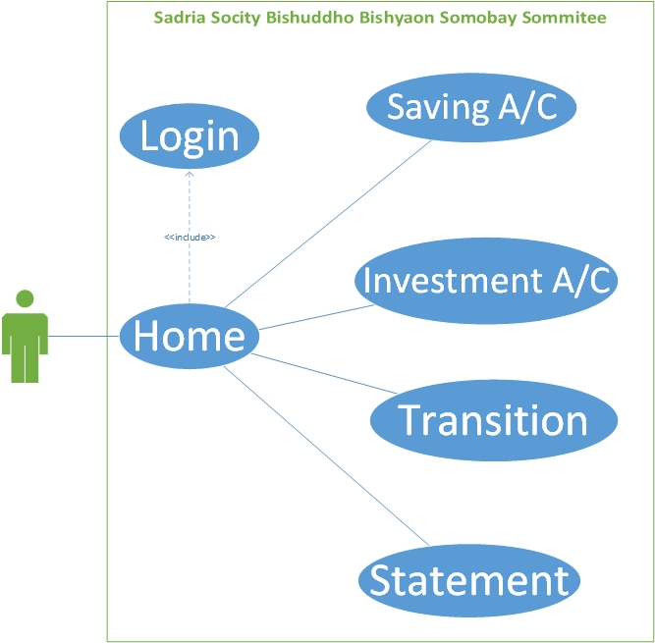
Use Case

Slide 5
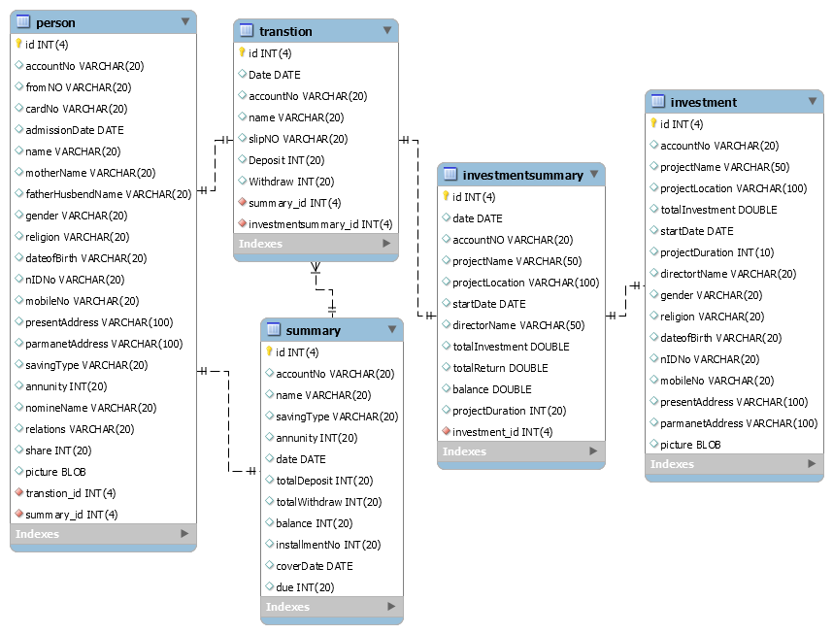
Class Diagram

Slide 6
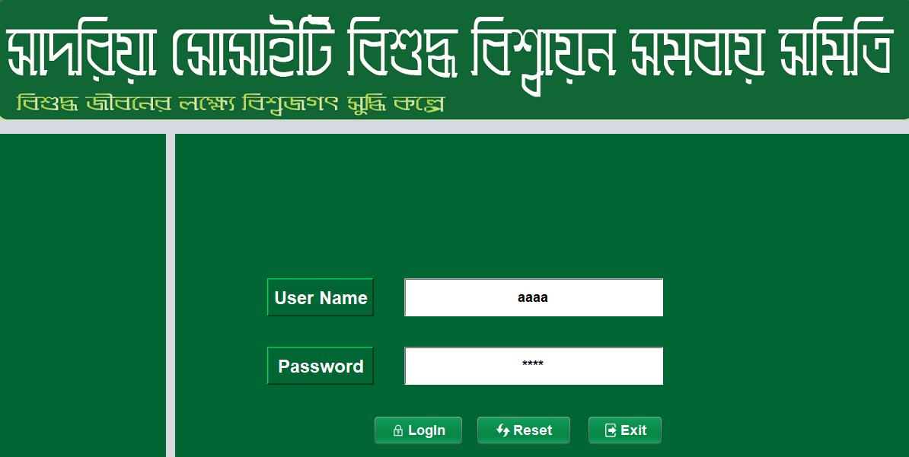
Login Page

Slide 7
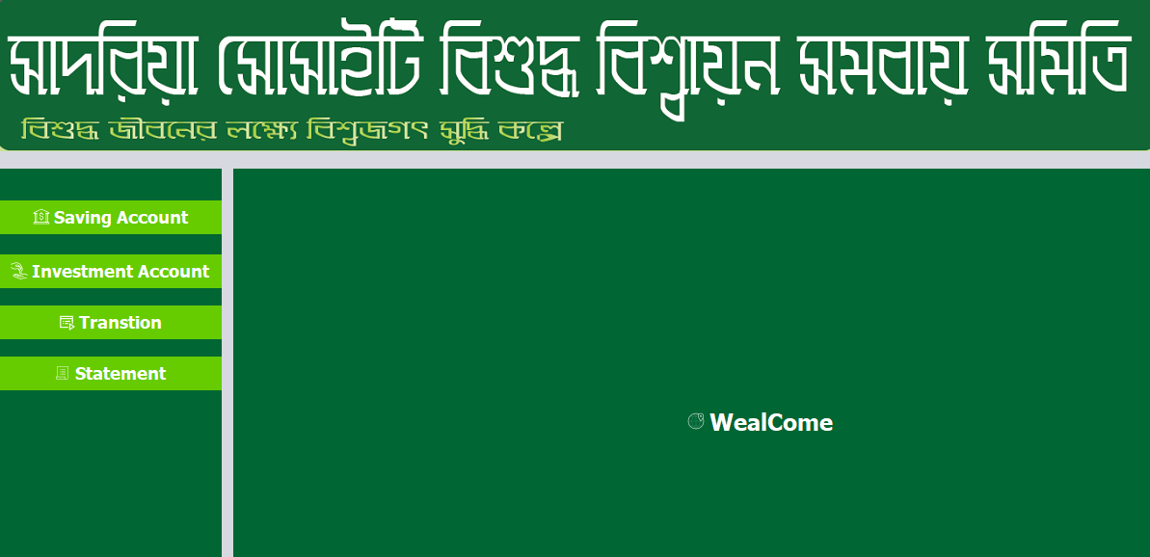
Home Page

Slide 8
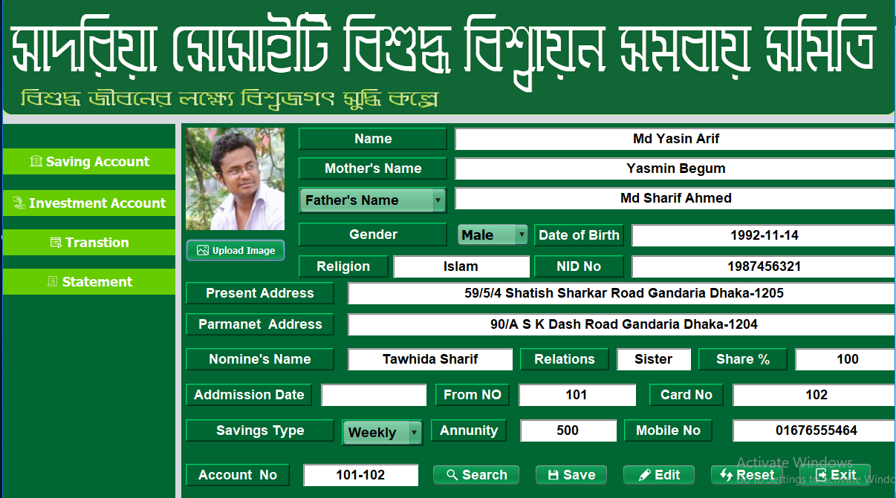
Saving A/C

Slide 9
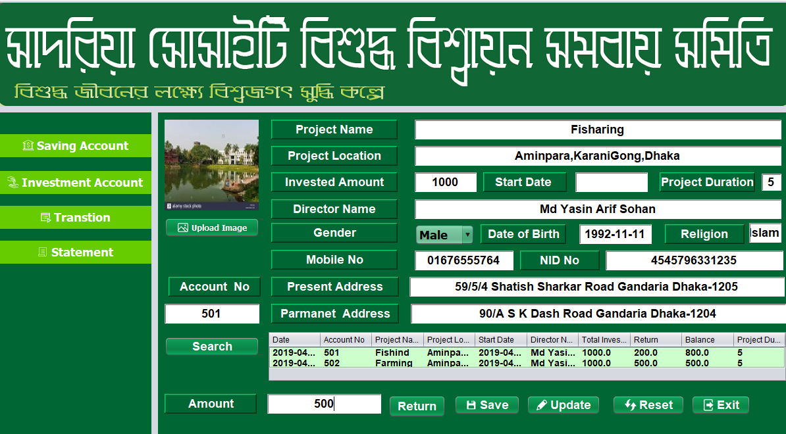
Investment A/C

Slide 10
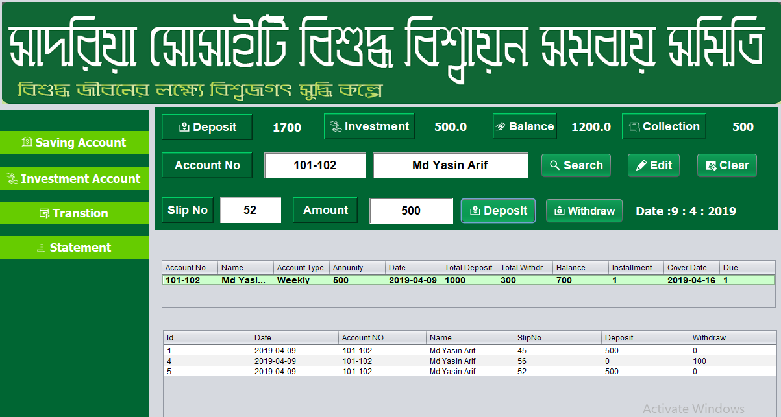
Transition

Slide 11
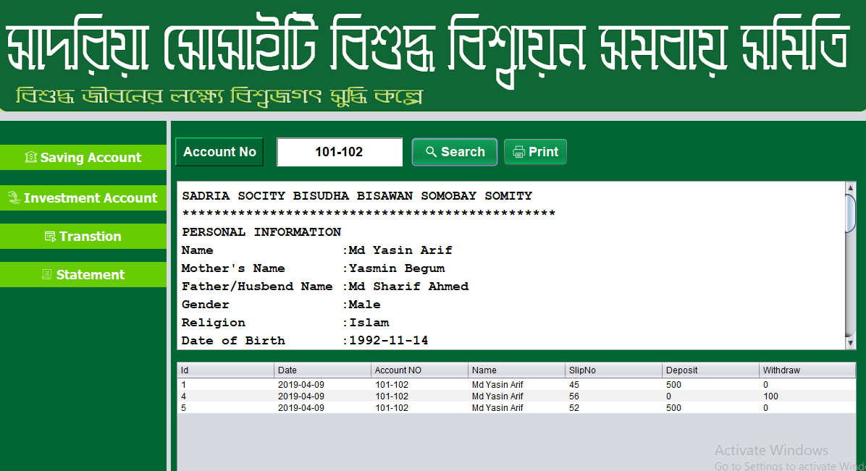
Statement

Slide 12
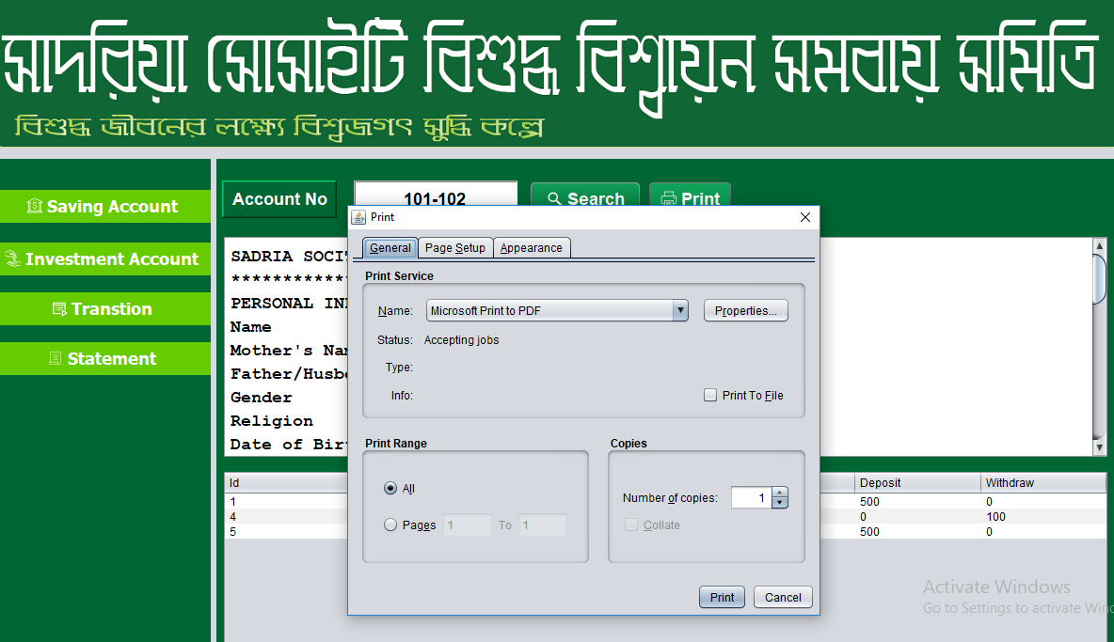
Print Statement

